Slide 1
Village at Nauset Green Eastham Affordable Housing Development

Slide 2
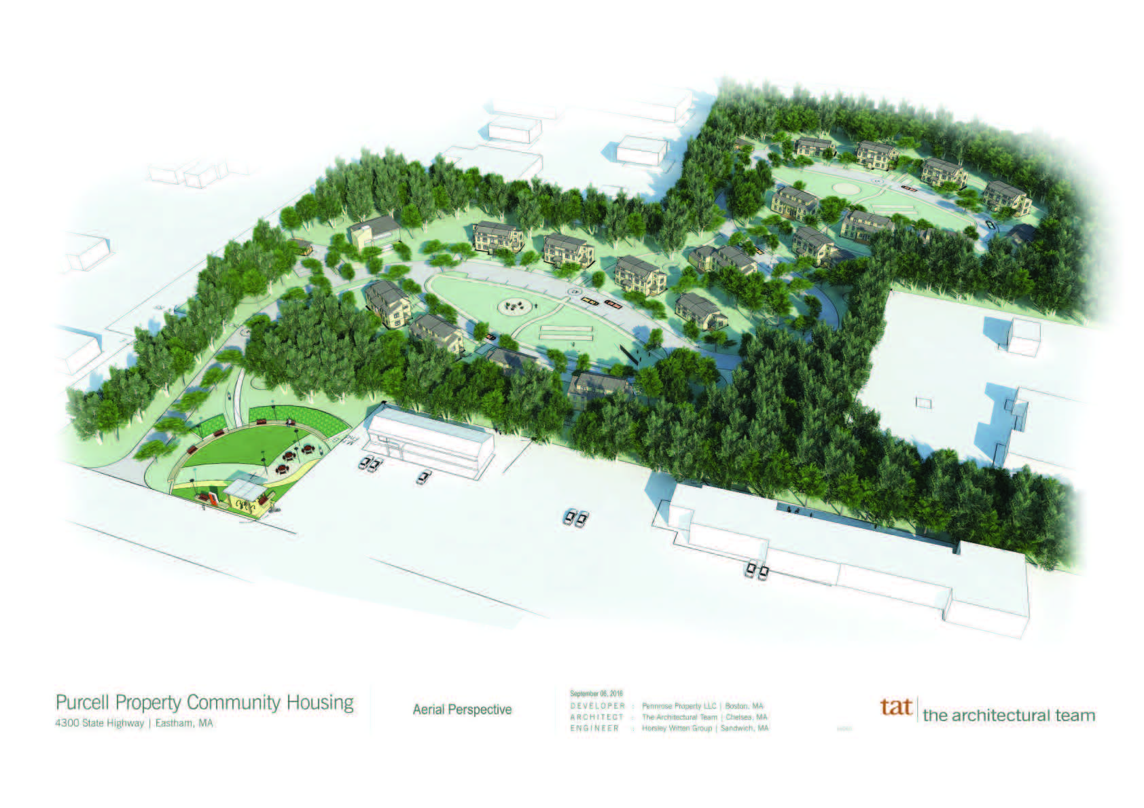
65 UNITS – ALL RENTAL
110 BEDROOMS
105 PARKING SPACES
10.5 ACRES
PUBLIC PARK
ON SITE WWTF
RTA BUS STOP

Slide 3
RFP PROCESS
GENRAL ITEMS
Construction and ongoing management
No more than 132 bedrooms
Favorability for design accommodating seniors but not restricted to seniors
99 Year Lease
Town subsidy towards infrastructure
UNIT CONFIGURATION/DESIGN
Mix of 1, 2 and 3 bedroom units (40% of units = 2 bedroom)
Townhouse design preferable (emphasis on context sensitive design to fit area)
AFFORDABILITY
40% units <= 120% AMI
25% units <= 80% AMI
5 Units <= 30% or 50% AMI (priority given to proposals including)
BOS wanted good mix of income levels to help create an organic neighborhood
2 proposals received, project awarded to Pennrose Properties Inc.

Slide 4
Memorandum of Agreement
Town waives 50% bldg. permit fees
Town contributes $400,000 for infrastructure
No direct access to Rte. 6
Requirements for building height, # parking spaces, town water, utility ROW, site amenities (playground, garden, bus stop), security, washer/dryer (on site or in units) etc.
Peer review fees ($10,000)

Slide 5
Regulatory Process
“Friendly” 40B Process
ZBA as sole local permit granting authority for “Comp Permit”
DEP approval required for wastewater treatment facility
Planning Board and Board of Health were asked to review proposal and provide ZBA with feedback/recommendations
Peer review for engineering, wastewater and traffic studies
Developers were very accommodating to ZBA info requests/timely submittals of information and appearing before other boards for “courtesy” reviews

Slide 6
Village at Nauset Green Final Design #s
UNIT MIX
65 units/18 residential buildings (27) 1 bedroom units (31) 2 bedroom Units (7) 3 bedroom units 1 Community Building 1 Wastewater Treatment Building
AFFORDABILITY MIX
25% <= 80% AMI
Min 38 Units reserved <= 60% AMI
Min 12 Units reserved <= 80% AMI
Balance of units reserved <= 120% AMI
LOCAL PREFERENCE MIX
65% Eastham Residents, Town/School Employees
10% Barnstable County residents
Town lobbied for max local preference but DHCD has final approval
11 units at 30% AMI
39 Units at 60% AMI
15 Units at 90% AMI

Slide 7
Funding Summary
Total Project = $23 Million
$300,000 Eastham CPA Award
$450,000 Eastham CPA Award
$400,000 Town Subsidy for Infrastructure
$300,000 Eastham Affordable Housing Trust
$100,000 Orleans CPA
$100,000 Wellfleet CPA
$875,000 over 5 years: State Funding
$10 Million over 10 years: Low Income Tax Credits
Other financing

Slide 8
Project Timeline
RFP issued: May 2016
Comprehensive Permit initiated: December 2016
Comprehensive Permit issued: March 2017
Groundbreaking: December 2018
Occupancy on first units: October 2019 (anticipated)

Slide 9
Take Aways
Context sensitive design very important to get community support and local funding take time to get public feedback on design options, go into RFP process with a good sense of what you want, what will work and what you can get
Be sure you can work with the developer, lots of twists and turns, many things out of the control of town and developer, financing can be unpredictable and can impact design throughout the process both sides need to be flexible
Take extra time for outreach to public and abutters and invite pertinent Boards/ Committees into the process
Local funding & support is key for securing State housing tax credits/demonstrate project is viable
Be aware of staff time (permitting/plans reviews/inspections) budget for additional hours and get agreement from developer to provide escrow funds to cover extra inspectional services

Slide 12
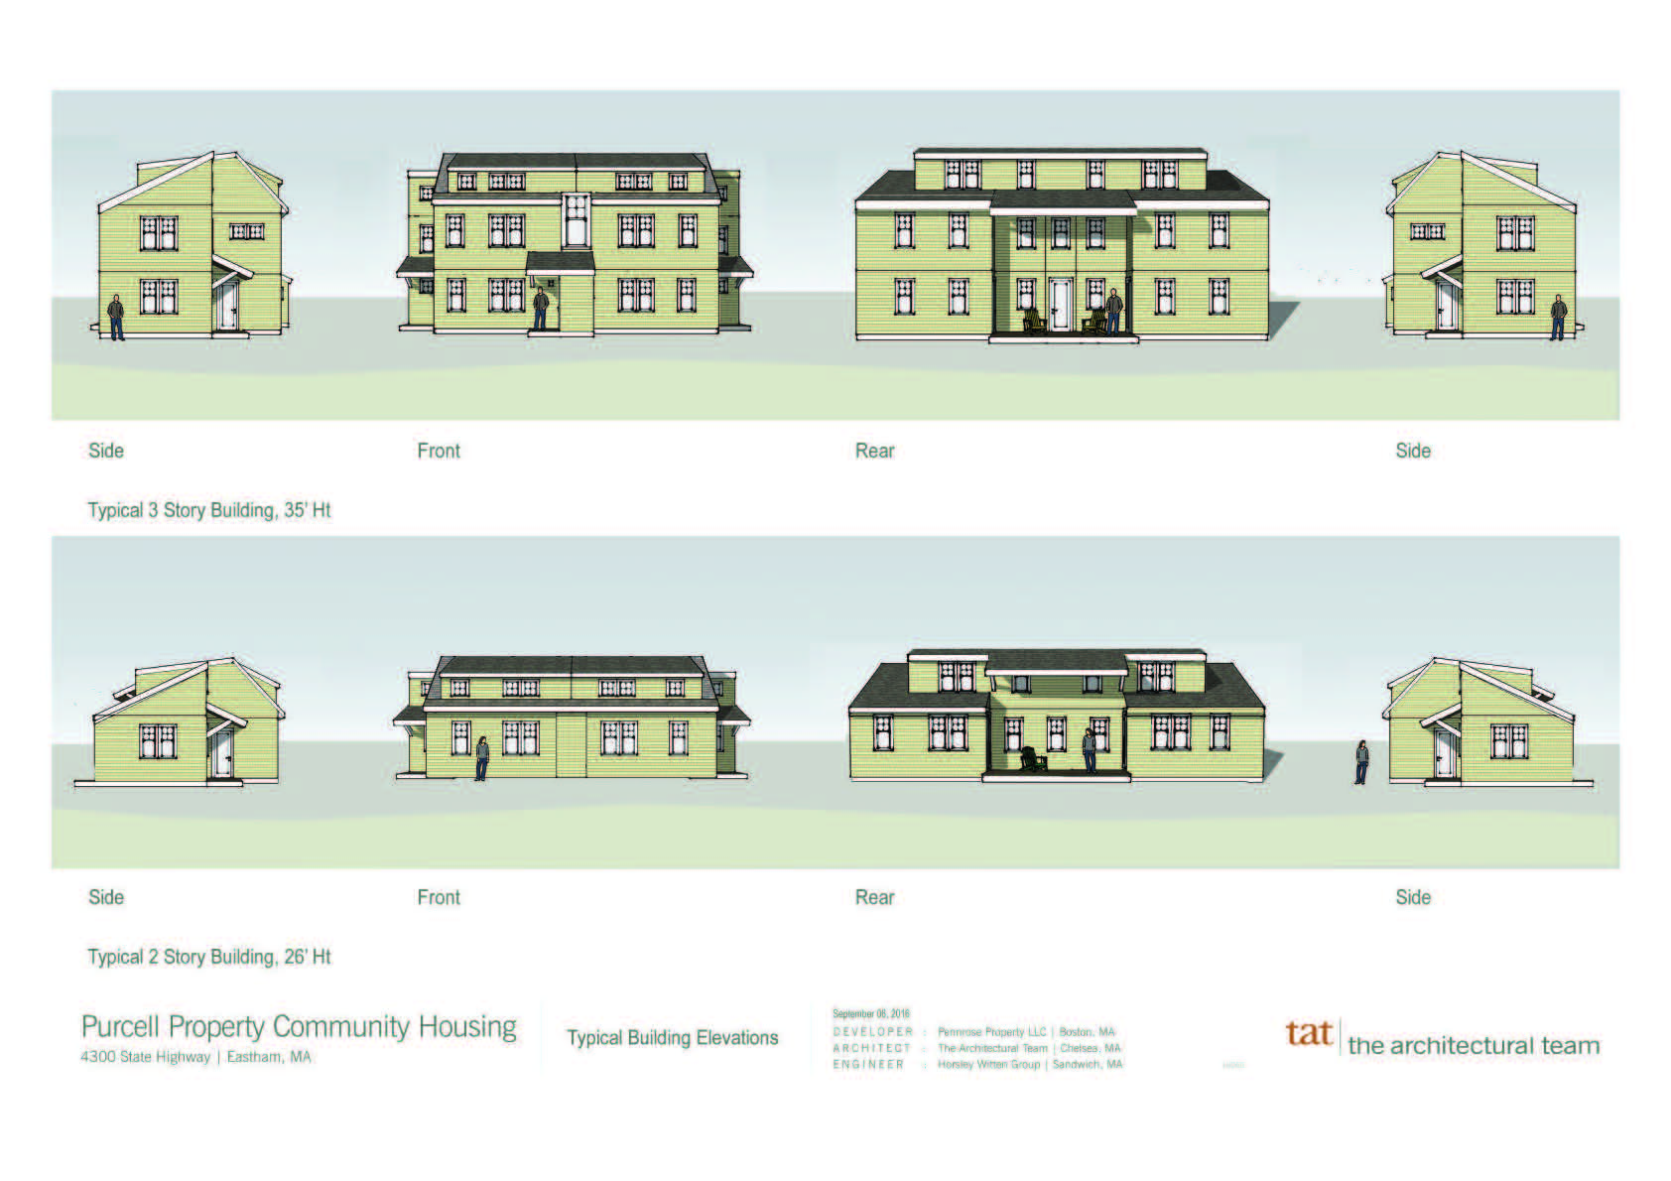

Slide 13
